Slide 1
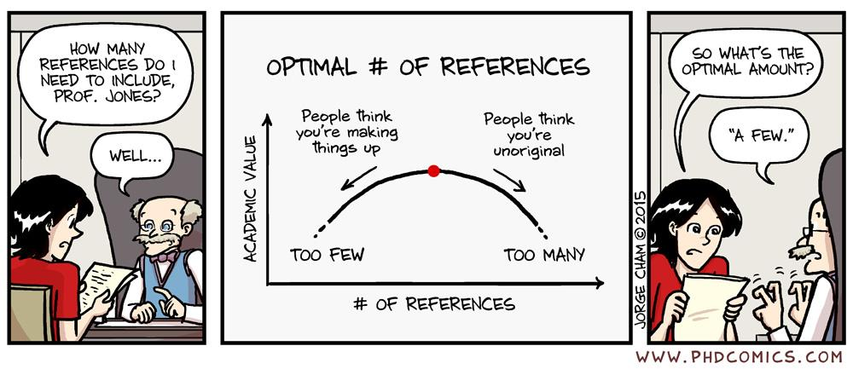
Welcome!
ENTMLGY 6702
Entomological Techniques and Data Analysis

Slide 2
Learning objectives
Introduce yourself to your classmates
Discuss the syllabus
Understand course objectives and our teaching approach/philosophy

Slide 3
Introduction cards
Name: Kayla Perry
Department: Entomology
Degree and adviser: PhD in Entomology from OSU; advised by Dr. Dan Herms
Research topic: responses of ground-dwelling insect communities to disturbance in forest ecosystems
Experience with scientific publishing: Published at least one peer-reviewed article
One uninteresting fact or hobby: I have three cats!
Career aspiration: develop a research program in forest insect ecology and train graduate students as a professor at an R1 institution

Slide 4
Introduction cards
Name: Samuel Ward
Department: Entomology
Degree and adviser: PhD in Entomology (Minor: Biostatistics) from U of MN; advised by Dr. Brian Aukema
Research topic: landscape ecology of forest insects
Experience with scientific publishing: Published at least one peer-reviewed article
One uninteresting fact or hobby: I have two dogs!
Career aspiration: improve management of forest health as a professor at an R1 institution

